Slide 1

Preparation
Before the class

Slide 2
IOS development Toolbox
We need to prepare everything you need to make apps for the iOS

Slide 3
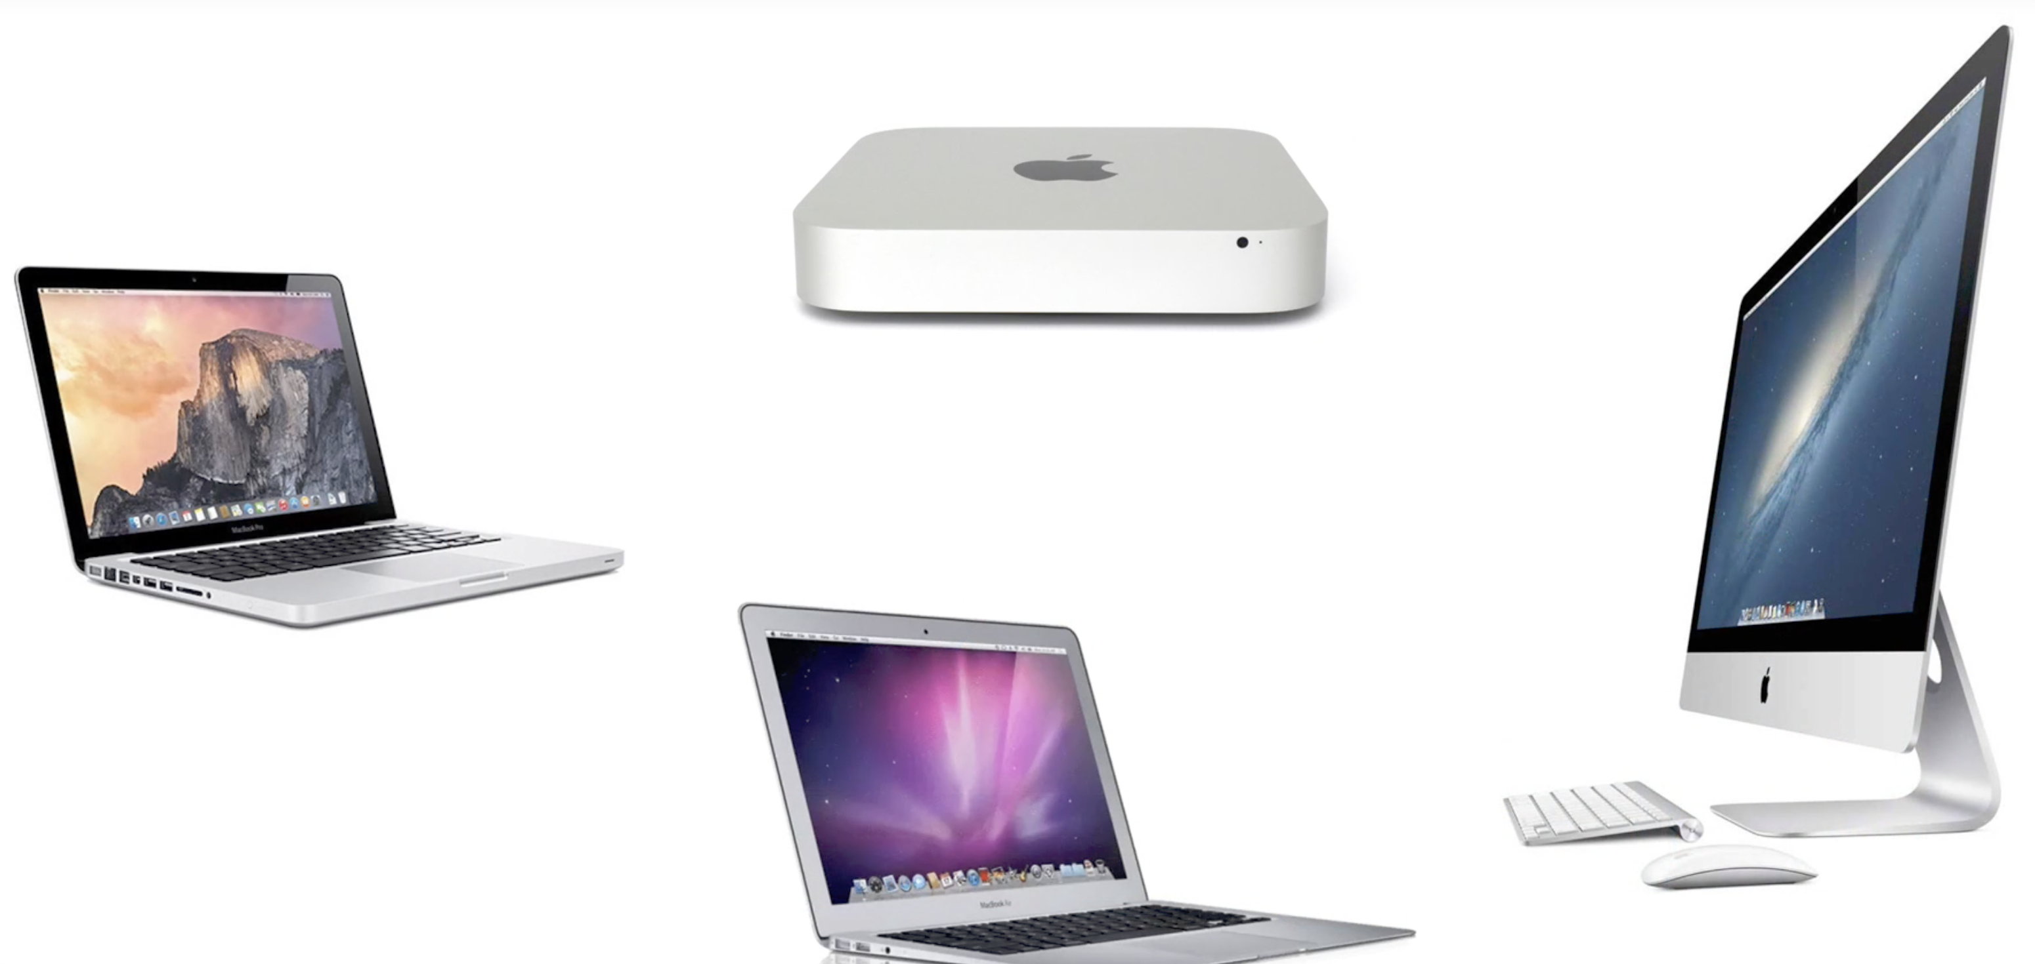
The First and most important thing
You need a mac PC(Notebook) with MacOS installed

Slide 4

If you don’t have any of them…
There are some ways… but not recommended

Slide 5

Mac on cloud
The easiest way for non-Mac person, but you still need to pay…
https://www.macincloud.com/

Slide 6
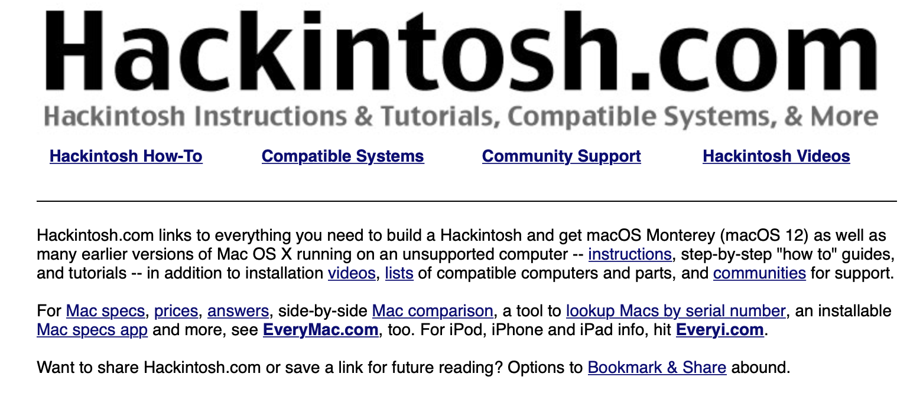
Hackintosh
Another way for users using non-MAC PC, but background of operating system is required.
https://hackintosh.com

Slide 7

After you have the hardware and MACOS
The next important thing is to install the software on it…

Slide 8
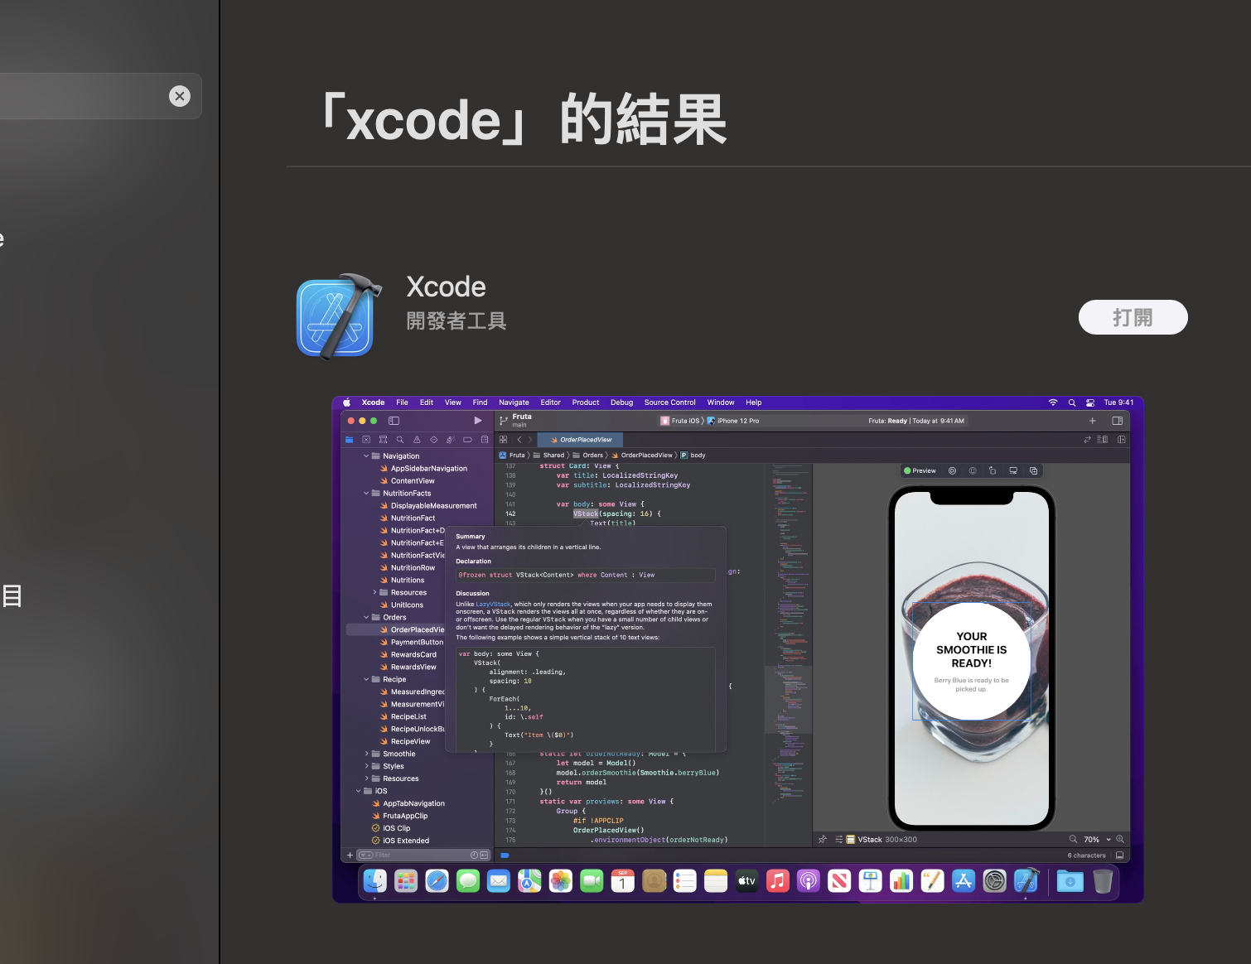
Xcode installation
Check the version of your macOS and suitable Xcode from here:
https://xcodereleases.com
Download the suitable version and install it.
If you have the newest macOS, you can go to the App store and search Xcode, then just install it

Slide 9
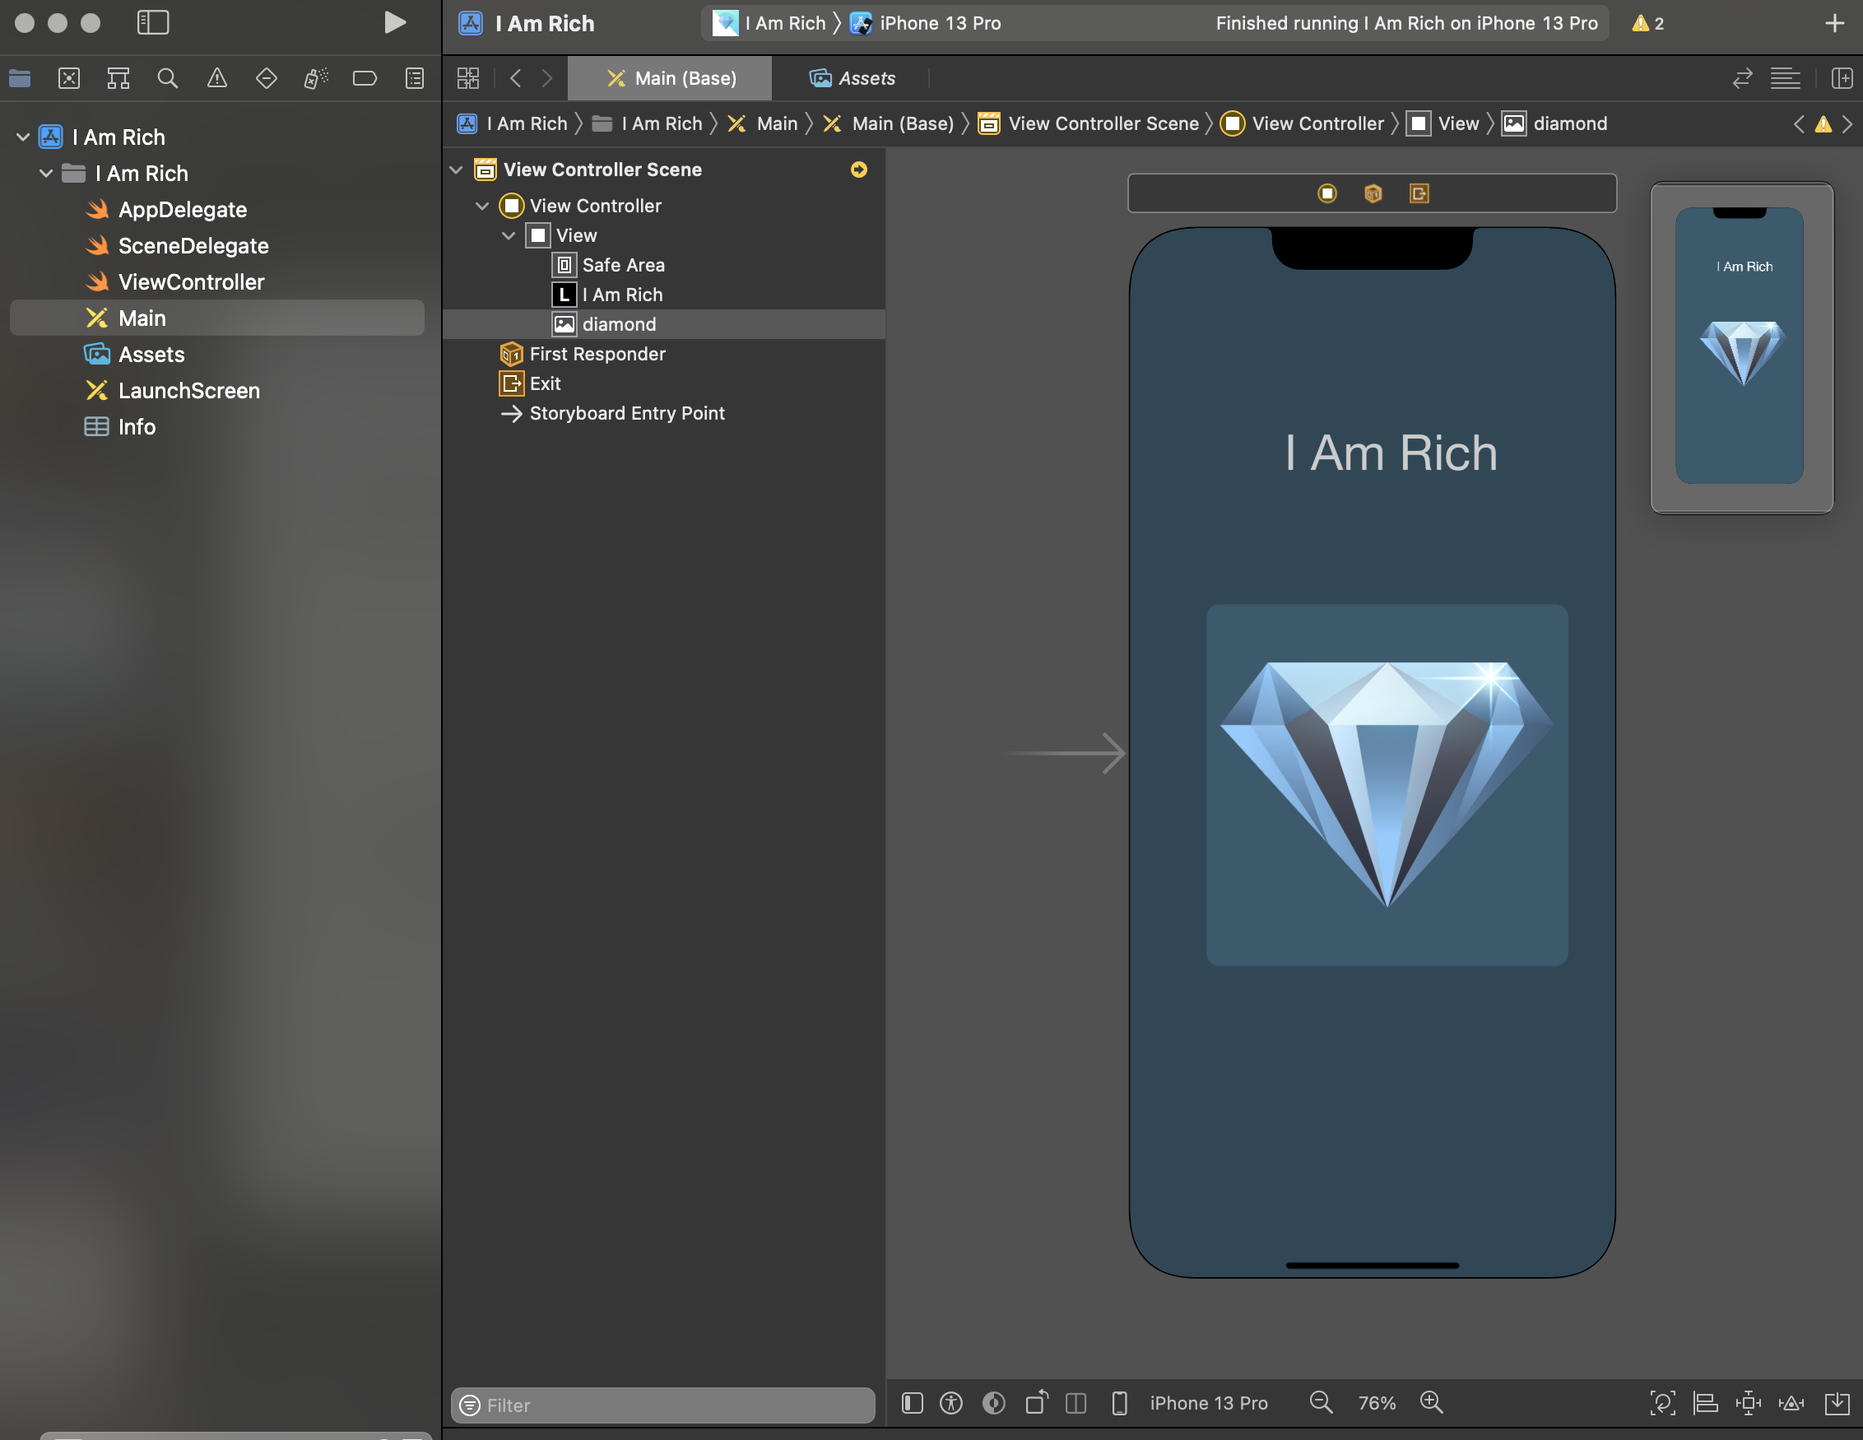
Try it!
start button
Download the “I-Am-Rich-iOS13-Completed-master.zip” project from E-learning.
https://elearning.pu.edu.tw/learn/path/download.php?path=xgAFq02szJ9YEZA06fXY2jCo5tXPNtXEq11ZBRwRPiMP8d3t9OllPswKmoiO-RfBWkhwI54xBeol37aGT8P1BKm3xTzMHhXQ
Unzip the folder and click the ‘I Am Rich.xcodeproj’ file.
Click the start button and Xcode will run the project on the simulator.

Slide 10
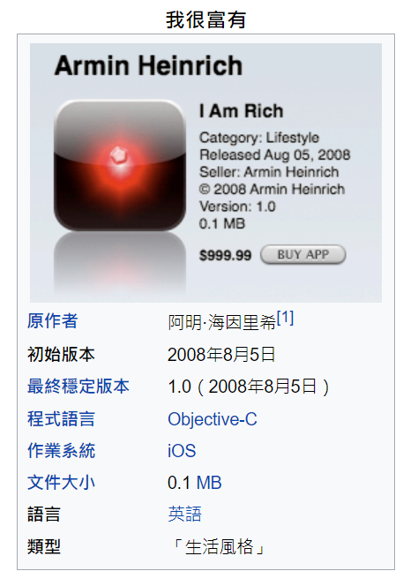
I am rich
Yes... I’m Rich… .
.
.
.
.
.
.
.
.
. . in the dream

